Slide 1
VIRTUAL MOUSE
Kokila P
Biomedical Engineering

Slide 2
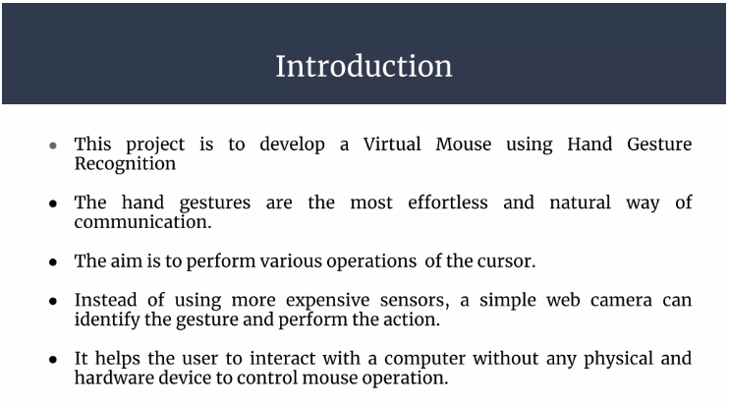
Introduction:

Slide 3
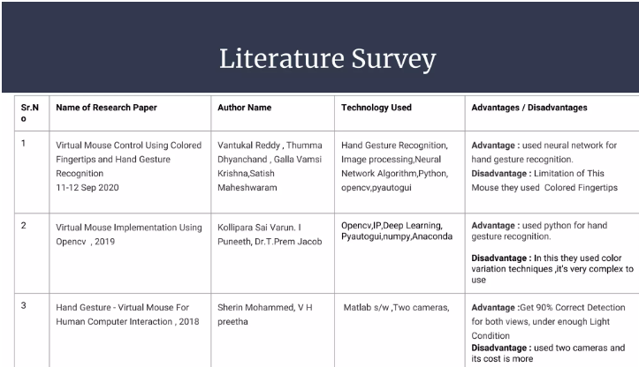

Slide 4
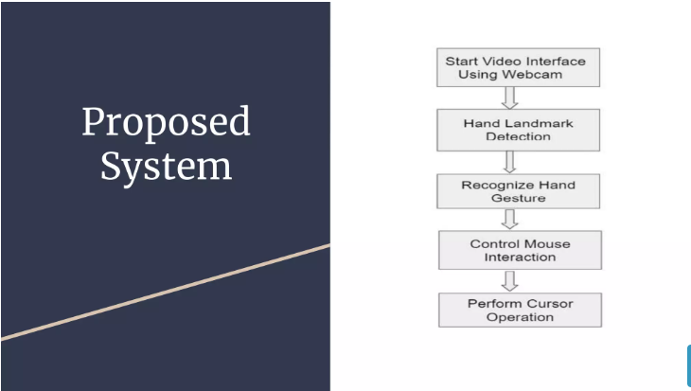

Slide 5
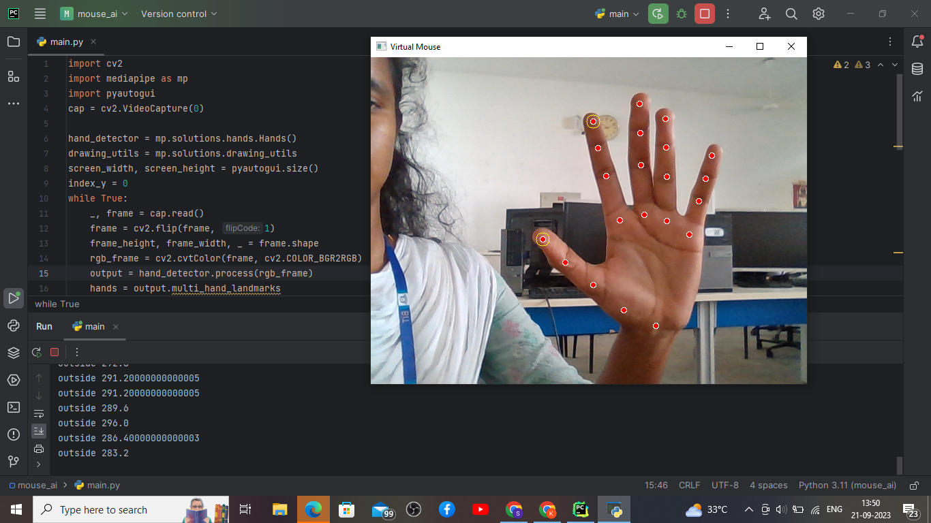
Implementation

Slide 6
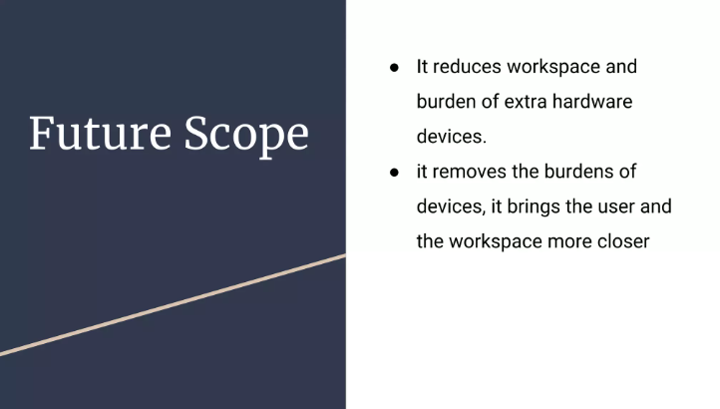

Slide 7
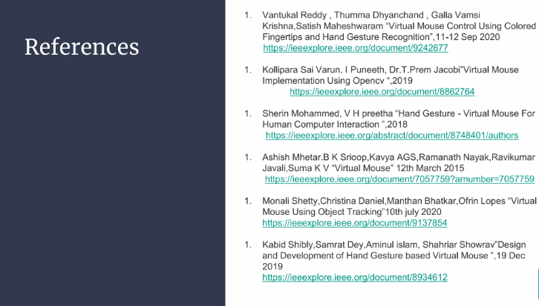

Slide 8
Thank you!!

